Slide 1
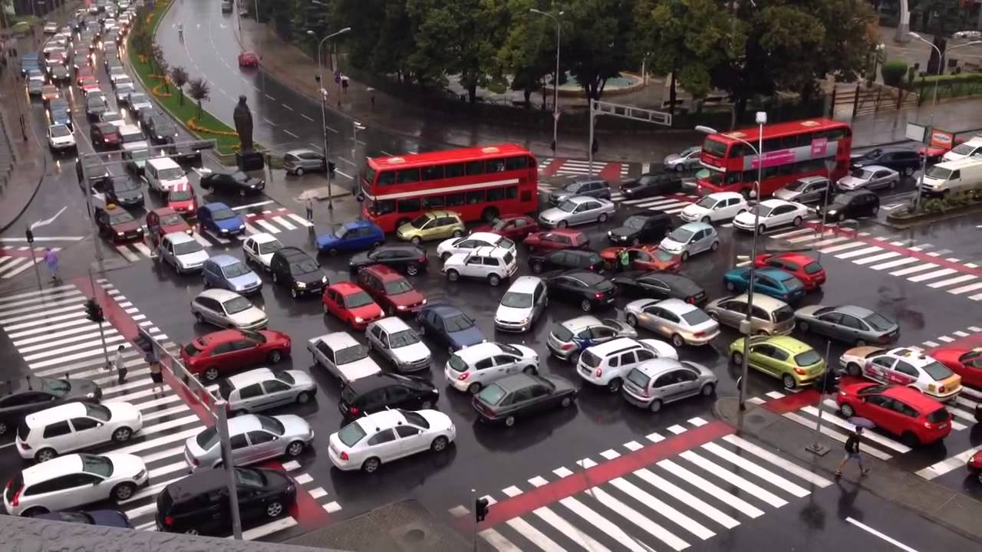

Traffic: From Chaos to Order
Tired of..
Being stuck in your car all day?
Losing your hearing to automotive horns blaring?
Your health and mood being affected by vehicle fumes caused by traffic jams?
The sight of a clogged intersection?
Then read on..

Slide 2
Solution?
Well timed traffic signals! – A large impact on traffic flow
Before
After
Congested traffic
Smooth Traffic
Traffic Data Analysis and Forecasting
Costly array of sensors for monitoring
Well timed traffic lights
Cleaner air
Badly timed signals
Saved costs of monitoring (sensors installation, maintenance)

Slide 3
Goal of this Study
Understand the flow of traffic through Data studies
Forecast traffic flow (with the ultimate goal of timing traffic signals) with 80% or more accuracy
What we did
Explored the trends in the data to understand it better
Prepared and modeled the data for time series forecasting
Compared the performance of three kinds of models: ARIMA, XGBoost and a Linear Regressor
What we found
The Linear Regressor model displayed better forecasting capability than the ARIMA model and at least as good as the XGB Model for the dataset
The Linear Regressor is also incredibly faster to train than the others and also meets the accuracy criteria, making it a good choice for forecasting

Slide 4

What was explored?
Data from the Mill Road Project was used for this study
This is hourly data for the flow of vehicles and pedestrians at the Mill Road area near Cambridge University, UK
This data will be analyzed to develop a model that will predict the traffic for the next hour based on a combination of expected traffic from several days of data at the time, and recent traffic hourly data.
This output can then be used to time the traffic signal appropriately.

Slide 5
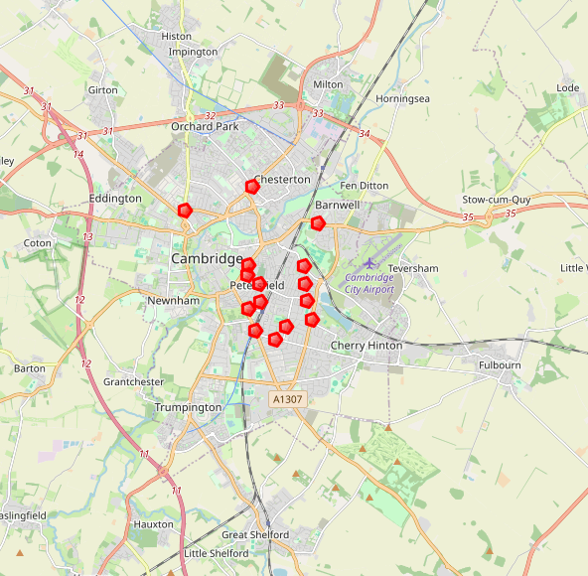
Map of sensors
The sensors are distributed in the area around Mill Road
The sensors together monitor most roads leading into or out of the area

Slide 6
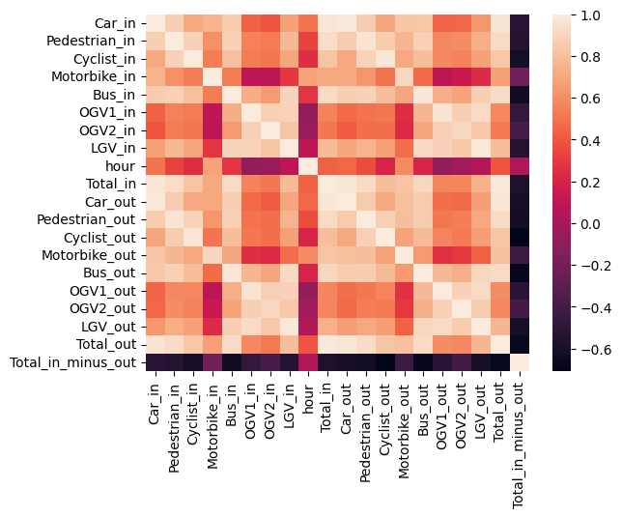
Correlations of different kinds of traffic?
A lot of the traffic are correlated.
The traffic congestion can be measured by ‘Total_out’ which is the sum of all different kinds of traffic out from the area
The strong correlation of many other variables to Total_out also bolsters our choice

Slide 7
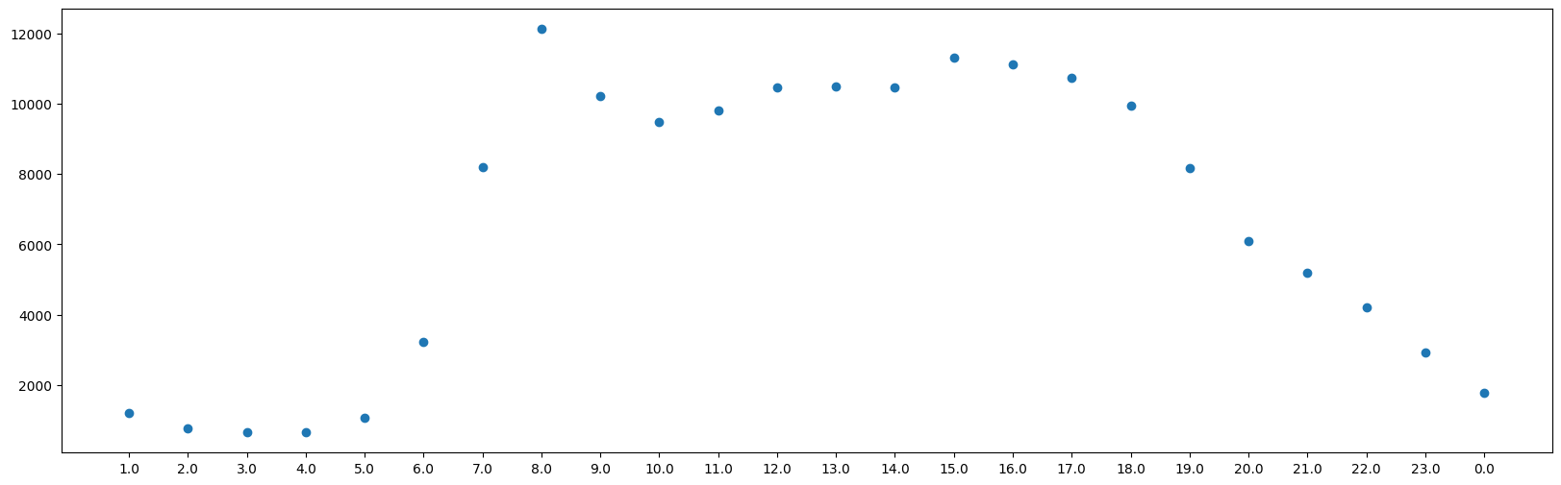
Traffic by Hour
Mean + 1std Total traffic by Hour
Traffic is low at early mornings and late evenings
It reaches a peak around 8 am and remains steady from 10 to about 5 pm, after which the traffic steadily declines
This is expected traffic pattern considering the times of day people are most busy with work, school, travel etc..
These values are later used to adjust the ARIMA model to try get better accuracy

Slide 8
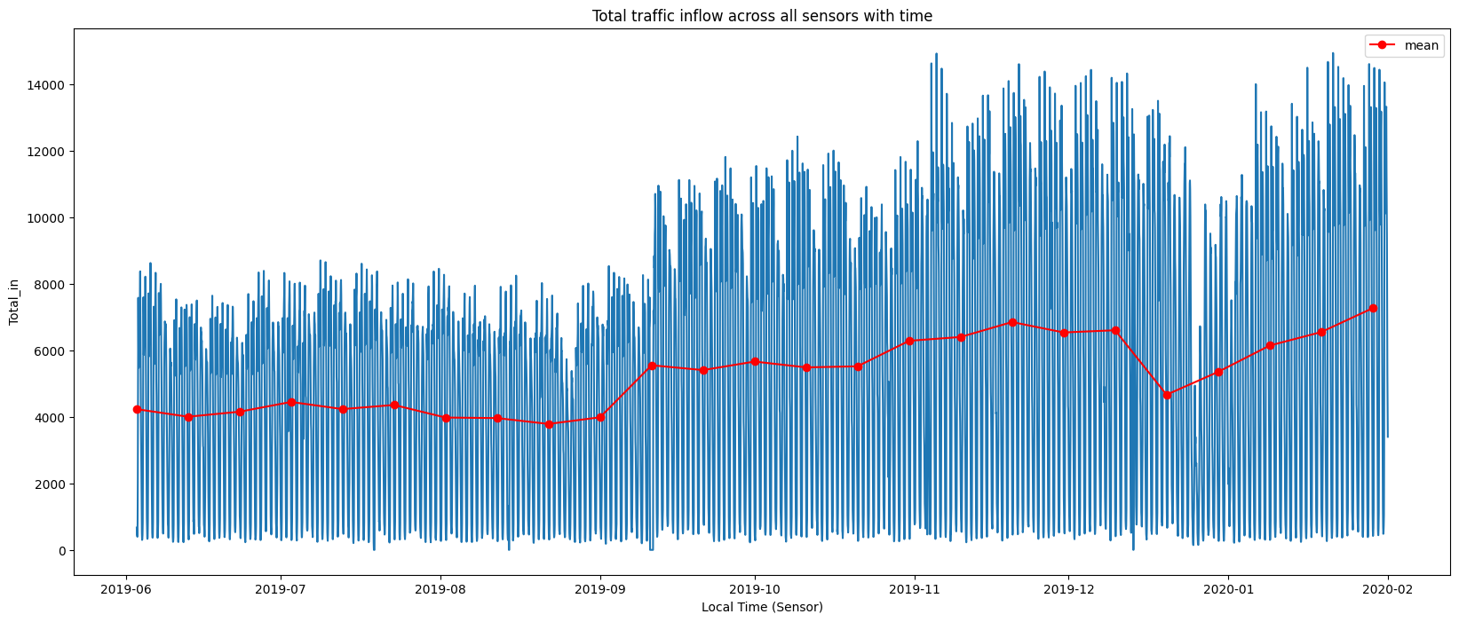
Traffic by Hour and Day across all sensors
There is a trend in observed traffic flow.
During the Christmas holiday season in December, the traffic drops, then picks up again into the following year
This data is non-stationary and would need to be accounted for in an ARIMA model

Slide 9
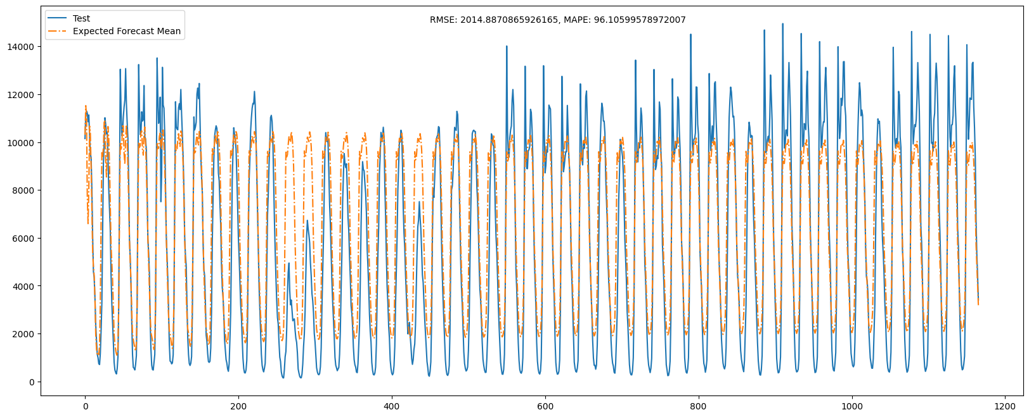
Model Performance: mean of ARIMA and Hour aggregate forecast
The RMSE is about 2014 and MAPE is 96.
Training time around 9 mins
The model is better at predicting general peaks and valleys but struggles at following seasonal trends in the data, such as the holidays at Christmas

Slide 10
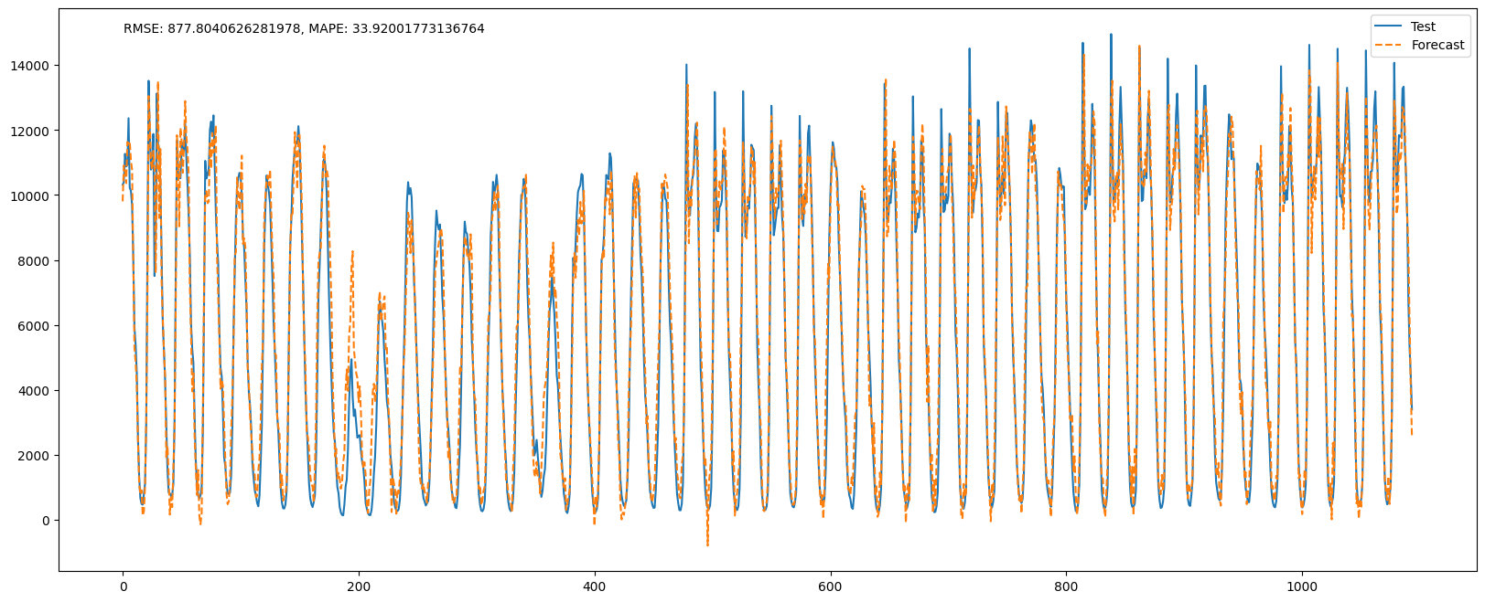
Model Performance: XGBoost Regressor
The RMSE is about 878 and MAPE around 34.
Training time around 5 mins
The model is able to follow most trends in the data, including seasonal trends
It is faster to train and more accurate than the ARIMA+hour based adjustment

Slide 11
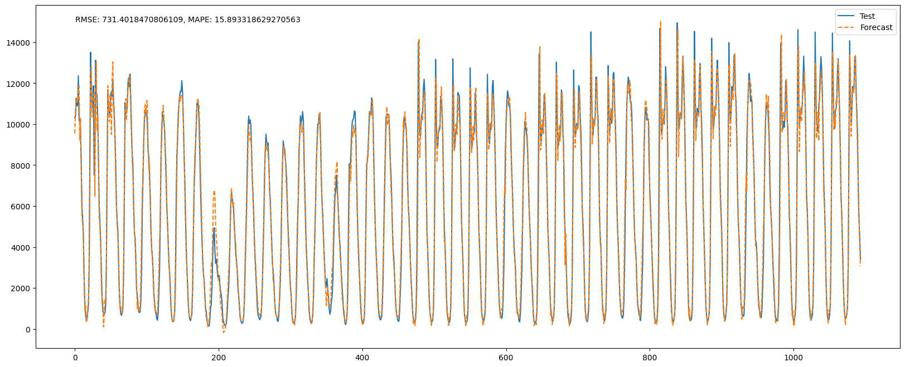
Model Performance: Linear Regressor
The RMSE is about 731 and MAPE around 16.
Training time around 0.4 mins
The model can follow most trends in the data, including seasonal trends
It is faster to train and more accurate than both the ARIMA and XGB Regression

Slide 12
Model Performance Matrix
Model | Training Time [minutes] | MAPE | RMSE
ARIMA (27,1,5) | 0.5 | 199 | 3677
ARIMA (27,1,50) | 8.75 | 147 | 2433
ARIMA (27,1,50) with expected sensor value | 8.75 | 80 | 2205
XGBoost Regressor | 5.0 | 33 | 878
Linear Regressor | 0.4 | 16 | 731
Since Linear Regressor is faster to train as well as more accurate than XGB and ARIMA, in addition to meeting the 80% accuracy target, it seems to be the best model to forecast the hourly traffic data

Slide 13
Recommendations
Use traffic flow simulation software timed as per the model forecast, in conjunction with historical timing, to match the traffic flow on test data. Several flow softwares such as SUMO, VISSIM and AIMSUN are available for this purpose
Implement this new timing system in real time once testing produces good results
Continue to monitor the traffic and check the performance of the model for future data beyond the test data
Retune the model if necessary

Slide 14
Challenges
Determining the parameter to model traffic with was the first challenge and involved some research.
The time complexity of the ARIMA model was a significant hindrance to effective ARIMA modeling; achieving models with higher 'q' values took unreasonable amounts of time.
Finding the optimum set of parameters for the XGB pipeline took a lot of trial and error.

